Slide 1
Generalized - ICP
2022.07.07
강경수
Notes:
Yu –adas proposal 발표를 시작하도록 하겠습니다.

Slide 2
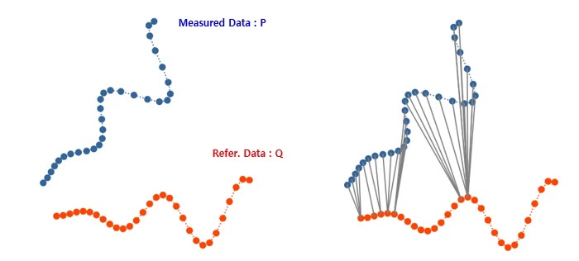
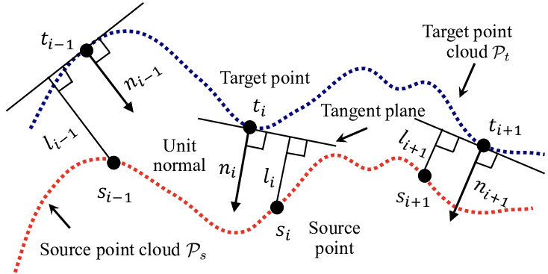
Topic & motivation
2 /
- 기존의 ICP
Point to point
Point to plane
Find closest point in src
Optimizing transform vector points distance → point to point normal vector ∙ points distance → point to plane

Slide 3
Topic & motivation
3 /
- 기존의 ICP
Point to point ICP
src
target
Rotation & translation Error present

Slide 4
Topic & motivation
4 /
- 확률론적 모델 도입
Find closest point in src
Optimizing transform vector Maximum likelihood estimation → G - ICP
more robust to incorrect correspondences
allow for the addition of outlier terms, measurement noise

Slide 5
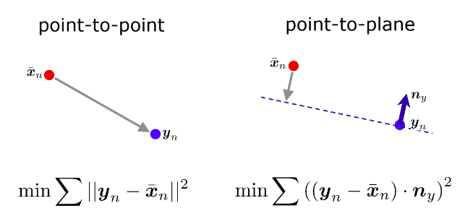
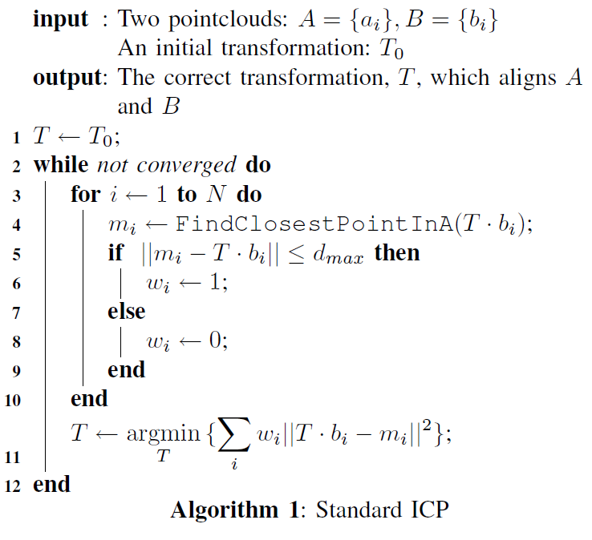
Related works
5 /
- point to point
Initial pose 설정
A에서 가장 가까운 point 찾기
거리를 통한 optimization

Slide 6

Related works
6 /
- point to plane
Initial pose 설정
A에서 가장 가까운 point 찾기
Normal vector 내적을 통한 optimization

Slide 7




Generalized - ICP
7 /
- 확률론적 모델링
실제 변환 관계
실제 trg 값
실제 src 값
측정된 값
실제 값
noise
$$a_{i} {\sim N(\hat{a}}_{i},C_{i}^{A})$$
$$\hat{b_{i}}=(T^{∗})\hat{a_{i}}$$
$$b_{i} {\sim N(\hat{b}}_{i},C_{i}^{B})$$
$$b_{i}−Ta_{i}=d_{i}^{T}$$
$d_{i}^{T^{∗}} \sim N(0, C_{i}^{B}+(T^{∗})C_{i}^{A}({T^{∗})}^{T})$
Distance can be made gaussian model

Slide 8

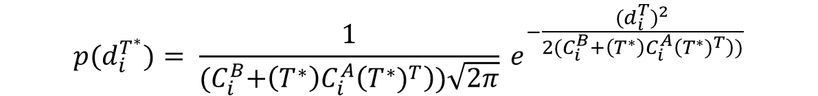
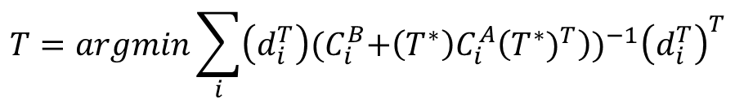
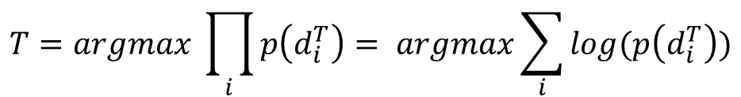
Generalized - ICP
8 /
- 확률론적 모델링
$${p(d}_{i}^{T^{∗}})= \frac{1}{{(C}_{i}^{B}+\left(T^{∗}\right)C_{i}^{A}\left({T^{∗})}^{T}\right))\sqrt{2π}} e^{−\frac{{{(d}_{i}^{T})}^{2}}{2(C_{i}^{B}+\left(T^{∗}\right)C_{i}^{A}\left({T^{∗})}^{T}\right))}}$$
$$T=argmax \prod_{i}{p\left(d_{i}^{T}\right)}= argmax\sum_{i}{log(p\left(d_{i}^{T}\right))}$$
$$T=argmin\sum_{i}{\left(d_{i}^{T}\right){{(C}_{i}^{B}+\left(T^{∗}\right)C_{i}^{A}\left({T^{∗})}^{T}\right))}^{−1}{\left(d_{i}^{T}\right)}^{T}}$$
https://en.wikipedia.org/wiki/Mahalanobis_distance

Slide 9

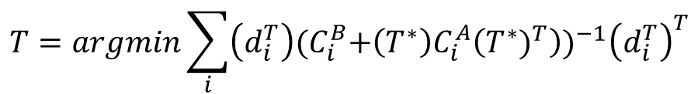
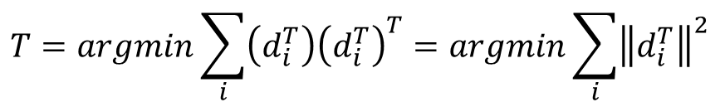
Generalized - ICP
9 /
- 확률론적 모델링
$$T=argmin\sum_{i}{\left(d_{i}^{T}\right){{(C}_{i}^{B}+\left(T^{∗}\right)C_{i}^{A}\left({T^{∗})}^{T}\right))}^{−1}{\left(d_{i}^{T}\right)}^{T}}$$
then, $C_{i}^{A}$ = 0, $C_{i}^{B}=I,$
$$T=argmin\sum_{i}{\left(d_{i}^{T}\right){\left(d_{i}^{T}\right)}^{T}}=argmin\sum_{i}{{\left\|d_{i}^{T}\right\|}^{2}}$$
Same as standard ICP algorithm
*
Standard ICP optimization

Slide 10
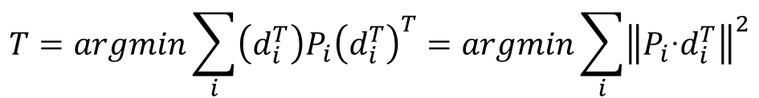
Generalized - ICP
10 /
- 확률론적 모델링
$$T=argmin\sum_{i}{\left(d_{i}^{T}\right){{(C}_{i}^{B}+\left(T^{∗}\right)C_{i}^{A}\left({T^{∗})}^{T}\right))}^{−1}{\left(d_{i}^{T}\right)}^{T}}$$
then, $C_{i}^{A}$ = 0, $C_{i}^{B}= P_{i}^{−1} (P_{i}$ is projection matrix of a’s surface normal)
$$T=argmin\sum_{i}{\left(d_{i}^{T}\right){P_{i}\left(d_{i}^{T}\right)}^{T}}=argmin\sum_{i}{{\left\|{P_{i}\text{∙}d}_{i}^{T}\right\|}^{2}}$$
Same as point to plane ICP
*
Point to plane ICP optimization

Slide 11
Generalized - ICP
11 /
- 확률론적 모델링
Standard ICP algorithm & point to plane ICP is special case in Generalized - ICP

Slide 12
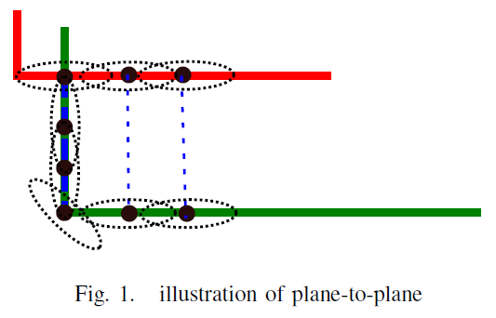
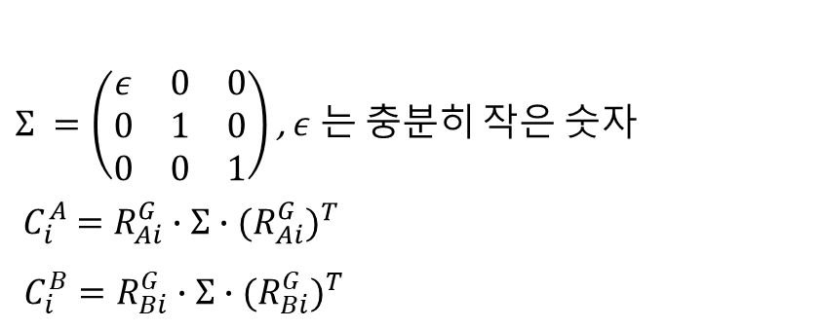
Generalized - ICP
12 /
- Plane to plane
$Σ =\left(\begin{matrix}ε & 0 & 0 \\ 0 & 1 & 0 \\ 0 & 0 & 1\end{matrix}\right)$ , $ε$ 는 충분히 작은 숫자 $${ C}_{i}^{A} =R_{Ai}^{G}∙Σ∙{{(R}_{Ai}^{G})}^{T}$$
$C_{i}^{B}=R_{Bi}^{G}∙Σ∙{{(R}_{Bi}^{G})}^{T}$
국소적 평면의 법선 방향으로만 작은 분산
공분산이 큰 방향으로는 최적화에 적은 기여도
공분산이 작은 방향으로는 최적화에 큰 기여도

Slide 13
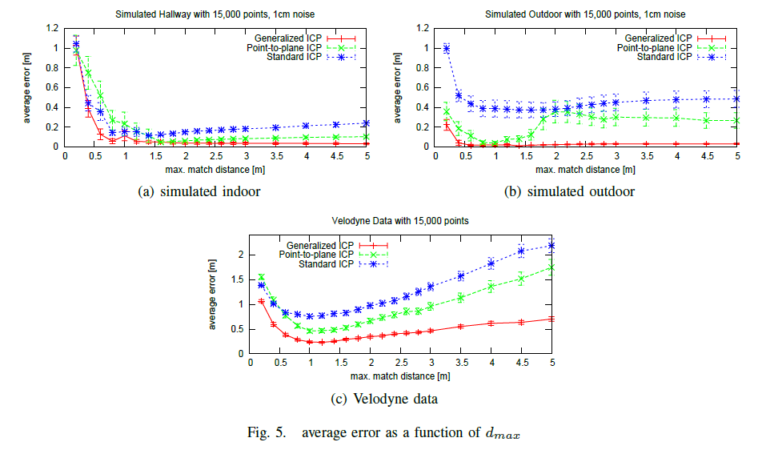
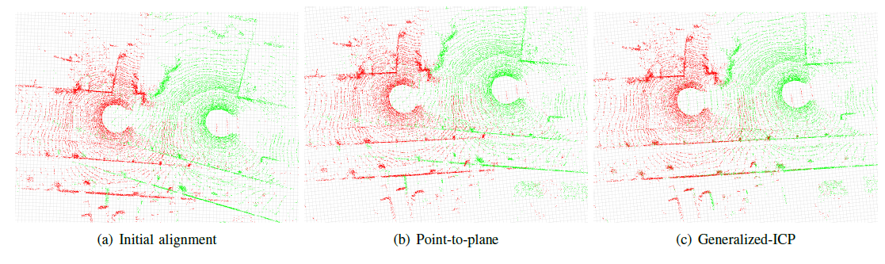
Result
13 /
G – ICP가 다른 ICP에 비해 높은 성능을 보임

Slide 14
감사합니다.
14 /

